Slide 1
Workshop on Impact Assessment at National Judicial Academy, Bhopal (02-06 Sept., 2015)
Existing Practices in SJAs for evaluating training impact
Santosh Snehi Mann, DHJS
Judge, MACT, Delhi

Slide 2
Agenda
Assessment & Evaluation
Training Needs Assessment
Training Impact Evaluation
Challenges
Way Forward

Slide 3
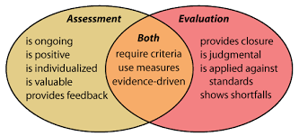
Assessment & Evaluation

Slide 4
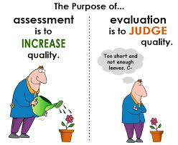

Slide 5
Training Need Assessment
Process by means of which the existing capacity/level is compared to the desired level
Institution Level: within & outside
Perception of Judiciary: Credibility, Quality & Efficiency
Individual Level: components of judicial work
Competency : Knowledge & Skill

Slide 6
Method
Feedback from the High Court
Feedback from the Judicial officers
Feedback from the Academicians, Lawyers & experts

Slide 7
Training Impact Evaluation
Process to assess the extent to which the learning/training outcomes are being used in practice
Institution Level: within & outside
Perception of Judiciary: Credibility, Quality & Efficiency
Individual Level: components of judicial work
Competency : Knowledge & Skill

Slide 8
Method
Feedback from the Participants regarding
expectations from the training
usefulness of training
Evaluation by the Participants about
Session plan
Resource person/Trainer
Methodology

Slide 9
Challenges
Feedback from High Court on the administrative & judicial side
Feedback from the Government
Feedback from court users, those interacting with courts & public/society
Feedback from those conducting surveys & studies on Perception of the Judiciary & working of courts
Feedback from the Media/Press
Criteria, Method & Analyses

Slide 10
Way Forward…
Formulation of a Judicial Education & Training Strategy
Need Assessment
Methods & Material
Impact Evaluation
Involvement of stake-holders & players responsible for and directly affected by working of courts

Slide 11
Thank You!!!

